Slide 1

Semantic Web Principles and Practice
Class 5: 27 May 2009

Slide 2

Class 5: Roadmap
Announcements and Assignments
Questions
SWWO Chapter 5
SWWO Chapter 6
SWP Chapter 3 (cont)

Slide 3
Chp 5: RDF and Inferencing
Data models and extracting information:
Dumb data and smart queries
vs
Smart data and inferencing

Slide 4
Inference in the Semantic Web
Class hierarchies in SW vs OOP
inference vs. polymorphism (p. 82)
B rdfs:subClassOf C means
every member of class B is a member of class C
this follows from inference
RDFS type propagation rule:
IF ?A rdfs:subClassOf ?B .
AND ?x rdf:type ?A .
THEN ?x rdf:type ?B .

Slide 5
Virtues of Inference-Based Semantics
Multiple Inheritance
C++ : not allowed
Java : implementation vs typing
C# : implementation vs typing
SW : allowed

Slide 6
Where are the Smarts ?
RDF store:
shop:Henleys rdfs:subClassOf shop:Shirts .
shop:ChamoisHenley rdf:type shop:Henleys .
SPARQL: ?x rfd:type shop:Shirts .
w/o inferencing, no results
using type propagation rule and inferencing:
?x = shop:ChamoisHenley

Slide 7
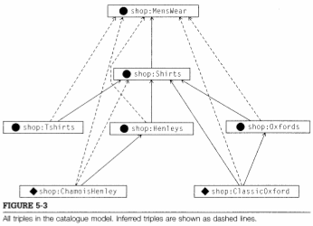
Asserted vs Inferred triples

Slide 8
Inferencing
When should inferencing happen?
Where should results be stored?
Inferencing makes data more consistent and connected and “smart.”
Inferencing depends on data model that includes rules such as type propagation rule.

Slide 9
CHP 6: RDF Schema
RDF models with graphs;
RDFS models with sets and graphs
A schema provides meta-data for:
XML - formats
RDB - table info
OOP - class structure
RDF - inference

Slide 10
RDFS in RDF : specify a set
A set is expressed as a rdfs:Class
ns:someThing rdf:type rdfs:Class .
Here, RDFS is identifying this triple as having a special, standardized meaning.
Individual membership vs “is a” relationship
IF A rdfs:subClassOf B .
AND r rdf:type A .
THEN r rdf:type B .
No inference for “else” or lack of asserted membership

Slide 11
More Patterns from RDFS
rdfs:subPropertyOf
Think “brother/sister” vs sibling
IF P rdfs:subPropertyOf R .
AND A P B .
THEN A R B .

Slide 12
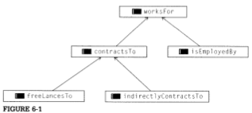
subPropertyOf example
Assert: Goldman isEmployedBy TheFirm .
Spence freeLancesTo TheFirm .
Long indirectlyContractsTo TheFirm .
Infer: Goldman worksFor TheFirm .
Spence contractsTo TheFirm .
Long contractsTo TheFirm .
Spence worksFor TheFirm .
Long worksFor TheFirm .

Slide 13
Typing Data by Property Usage
IF P rdfs:domain D .
AND x P y .
THEN x rdf:type D.
IF P rdfs:range R .
AND x P y .
THEN y rdf:type R .

Slide 14
Combining Domain and Range
ns:MarriedWoman rdfs:subClassOf ns:Woman .
ns:maidenName rdfs:domain ns:MarriedWoman .
IF X ns:maidenName Y .
THEN X rdf:type ns:MarriedWoman .
X rdf:type ns:Woman .
AND
ns:maidenName rdfs:domain ns:Woman

Slide 15
Combining Domain and Range (2)
In general,
IF P rdfs:domain D .
AND D rdfs:subClassOf C .
THEN P rdfs:domain C .
Similarly for rdfs:range
These definitions are very powerful … stay tuned.
Note: properties are defined independent of class !!

Slide 16
RDFS Modeling Combinations & Patterns
Set intersection is not directly available, but:
in one direction, we can get C ⊆ A ∩ B .
C rdfs:subClassOf A .
C rdfs:subClassOf B .
Assert:
x rdf:type C .
Infer:
x rdf:type B .
x rdf:type A .

Slide 17
RDFS Modeling Combinations & Patterns (2)
Property Set Intersection: P ⊆ R ∩ S .
Assert:
x P y .
Infer:
x R y .
x S y .

Slide 18
RDFS Modeling Combinations & Patterns (3)
Set Union: A ∪ B ⊆ C .
Assert:
A rdfs:subClassOf C .
B rdfs:subClassOf C .
x rdf:type A . OR x rdf:type B .
Infer:
x rdf:type C .
Similar logic for subPropertyOf.

Slide 19
RDFS Modeling Combinations & Patterns (4)
Property Transfer
Problem: merging data from two ontologies where we want to make two properties equivalent:
P rdfs:subPropertyOf Q .

Slide 20
Challenges: Term Reconciliation
Enforce that any member of one class is automatically treated as a member of another class: Analyst and Researcher .
>> Researcher is special case of analyst:
:Researcher rdfs:subClassOf :Analyst .
>> Each is partially equivalent to the other:
Union pattern
:Analyst rdfs:subClassOf :Investigator .
:Researcher rdfs:subClassOf :Investigator .
(:Investigator is a federated handle for these)

Slide 21
Challenges: Term Reconciliation (2)
>> Both are equivalent in all ways:
:Researcher rdfs:subClassOf :Analyst .
: Analyst rdfs:subClassOf : Researcher.

Slide 22
Challenges: Instance-Level Data Integration
>> Define a single class whose contents includes all the individuals from all of a set of data sources:
fc:CivilianFacility rdfs:subClassOf cc:OffLimits .
space:NoFyyZone rdfs:subClassOf cc:OffLimits .

Slide 23
Challenges: Readable Labels
Provide human-readable text for URIs
>> use rdfs:label
:personName rdfs:subPropertyOf rdfs:label .
:movieTitle rdfs:subPropertyOf rdfs:label .

Slide 24
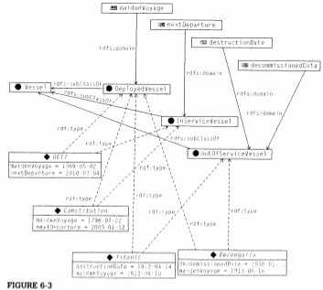
Challenges: Data Typing Based on Use
Automatically classify each vessel into specific subclasses depending on info available?
ALSO: Express that the commander of a ship has the rank of captain ? :
see text p. 114.
ALSO: Filtering Undefined data? :
See text p. 115.

Slide 25
Non-Modeling Properties in RDFS
rdfs:seeAlso
rdfs:isDefinedBy
rdfs:isDefinedBy rdfs:subPropertyOf rdfs:seeAlso
rdfs:comment

